Slide 1
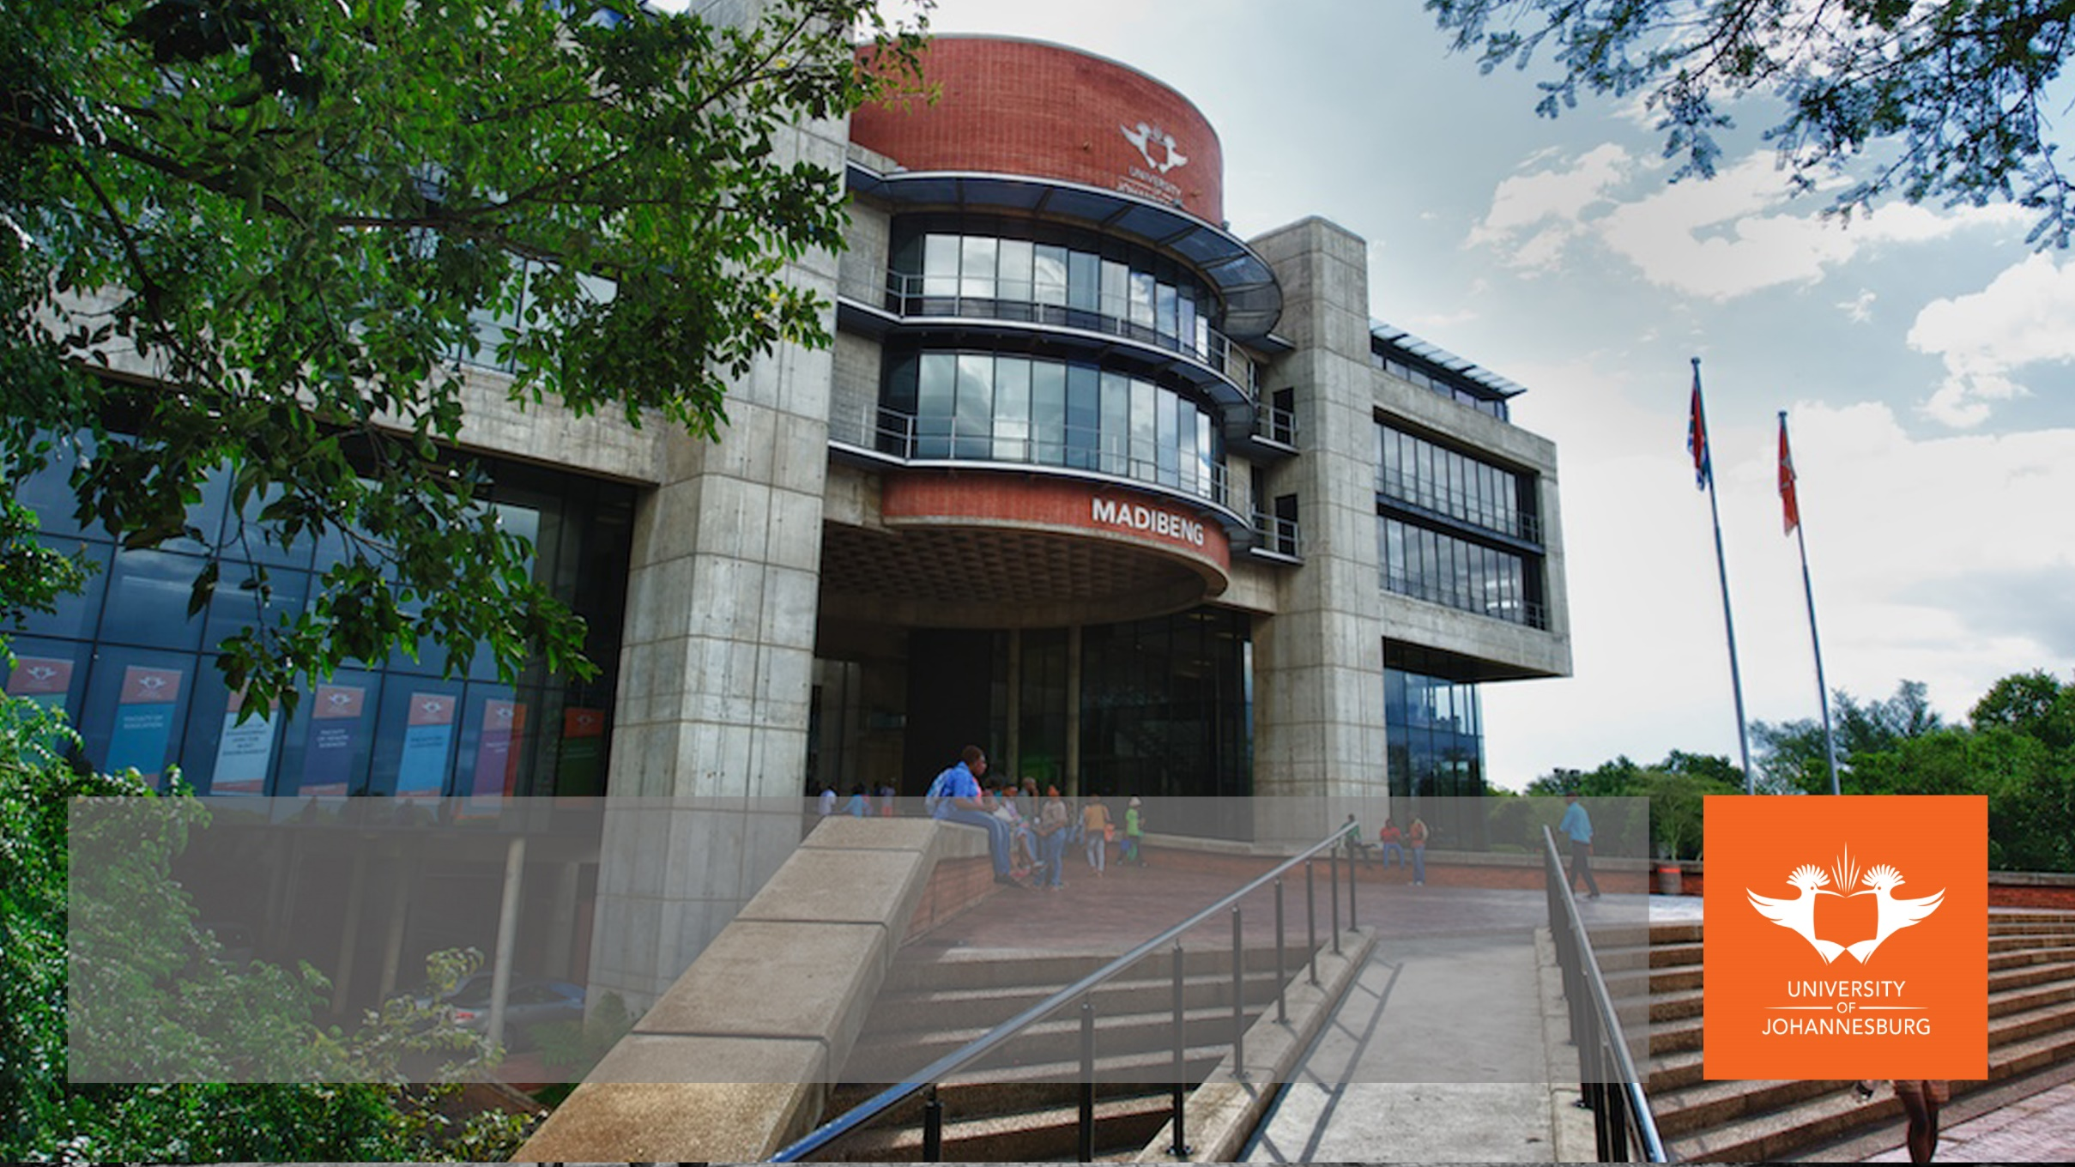

Automation of Graduation Planning & Execution
Presented by University Of Johannesburg
10 MARCH 2025

Slide 2


Graduation Ceremony
Graduation Ceremony 10 March 2025

Slide 3

the BIG ask
Is technology making graduation planning and execution EASIER,
BETTER AND
FASTER?

Slide 4
Overview - Roadmap
1 Year Before
Ceremony dates populated in the year programme
Previous # plus 10
Graduates Comply Fictitious Date Captured
End Dec for Season 1
End Mar Season 2
Mid Aug Season 3
Communicate with Graduates
Letter 6 weeks before
eTicket 1 week before
Programme on website
01
02
03
04
05
Fictitious Dates Established
Sunday at 00:00 prior to the commencement of the season.
Split into Ceremonies of 230 candidates
Bulk Update to Actual Dates
Notes:
At UJ we schedule ceremonies a year before in the year programme. We then establish a fictitious date for each season of ceremonies. This is a dummy date that is updated on the students record at the same time that the graduation status is updated. It indicates which graduation season the student complies for. Once all candidates are updated the faculties are divided into actual ceremony dates and times and the graduates are divided into those ceremonies. We then do a bulk update of date and time to change from the fictitious date to the actual date. Then letters are generated and eTickets sent to graduates.

Slide 5
Overview - Frequency /
Timing /
Scheduling
Max 230 candidates per ceremony
Tickets
3 guests per candidate
5 per doctoral candidate
Max 3 ceremonies
per day
09h30 13h00 16h30
1.5 -2 hours
November Summative Assessment
All candidates captured by end December
Summer
September October
10 ceremonies
n=1200
Autumn
March April May
60 ceremonies
n=12000
Winter
June
12 ceremonies
n=3000
January till 31 March
Special and Supplementary
1 April till End July
Masters and Doctoral
Special and Supplementary
All Subsidised Qualifications
Non-subsidised
qualifications 120 credits
Honorary Doctoral Degrees
- Virtual
- In-person
www.uj.ac.za
Notes:
Start at the circle to explain who is included in main ceremonies. Short learning programmes and attendance courses do not qualify to graduate at the main ceremony.
Explain about the seasons and who complies and how many ceremonies and when they take place.
Then explain how many ceremonies per day the duration, how many tickets each candidate gets.
Sometimes there are also honorary degrees conferred which include virtual and in person conferrals.

Slide 6

Communication Methods
Notes:
Lets look at the different communication methods we use to keep the graduate informed before the ceremony as well as after the ceremony

Slide 7

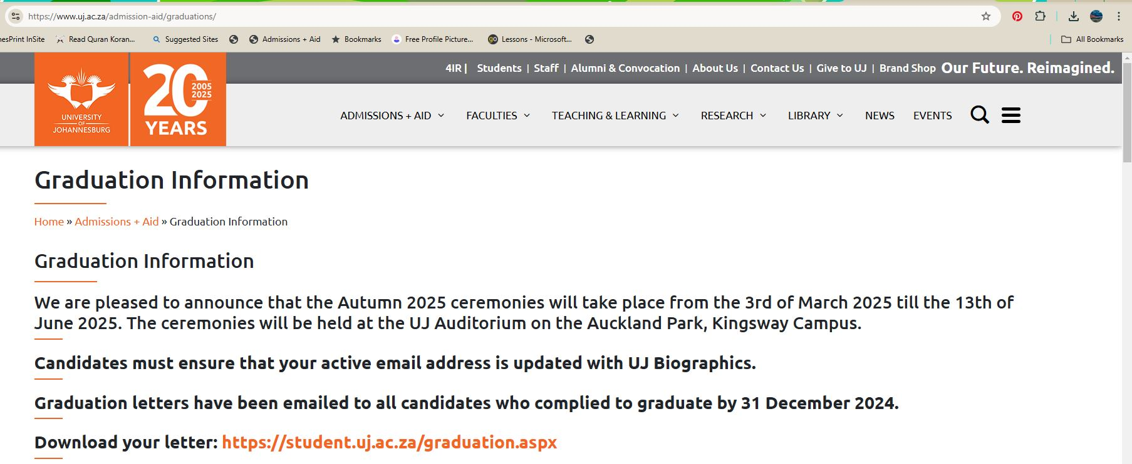
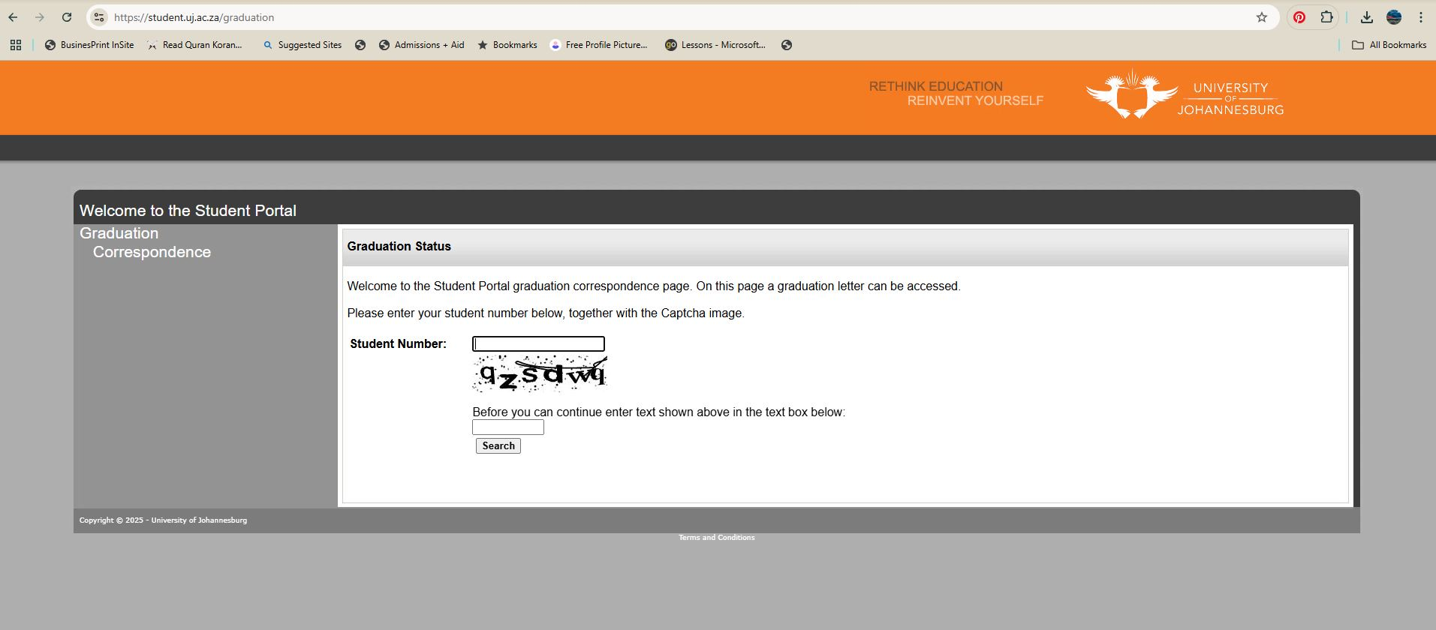
Graduation Invitation Letters
In the past we printed, folded and posted letters.
Now we generate it via ITS iComms and email the letters to the graduates.
They are automatically able to download their letter on a UJ website where they verify who they are to access the document.

Slide 8


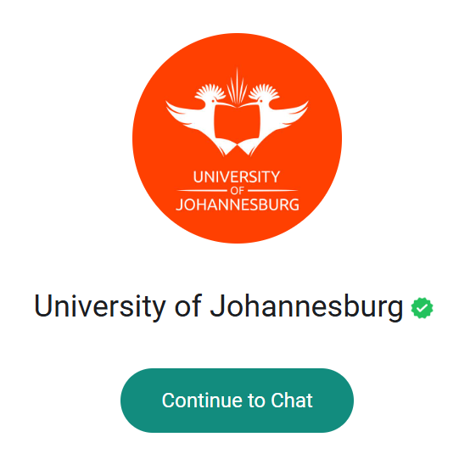


Graduation WhatsApp Information
Notes:
Graduates can navigate to our whatsapp chat function via the contact us information on our website and talk to a call centre agent

Slide 9
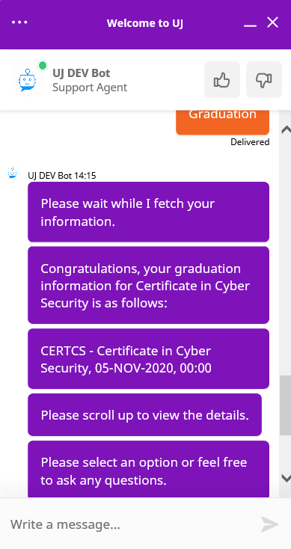
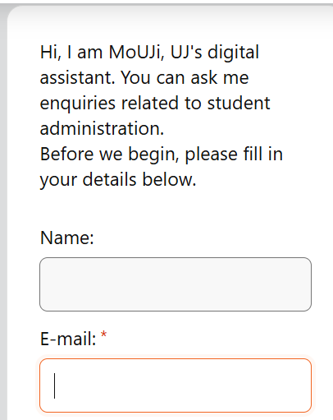
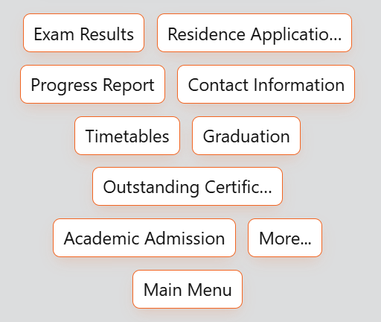

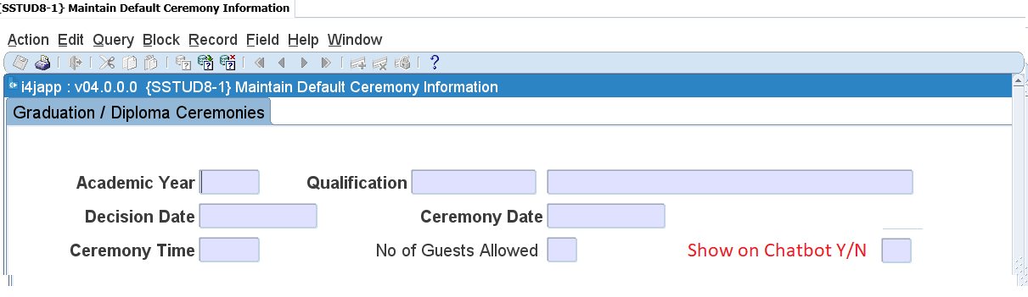
Graduation Chatbot Information
Notes:
Click - We have a chatbot available on our website where graduates can enquire about general as well as personal information about their graduation ceremony.
Click - This integration is available from the ITSintegrator environment when setup via SSTUD8-1

Slide 10
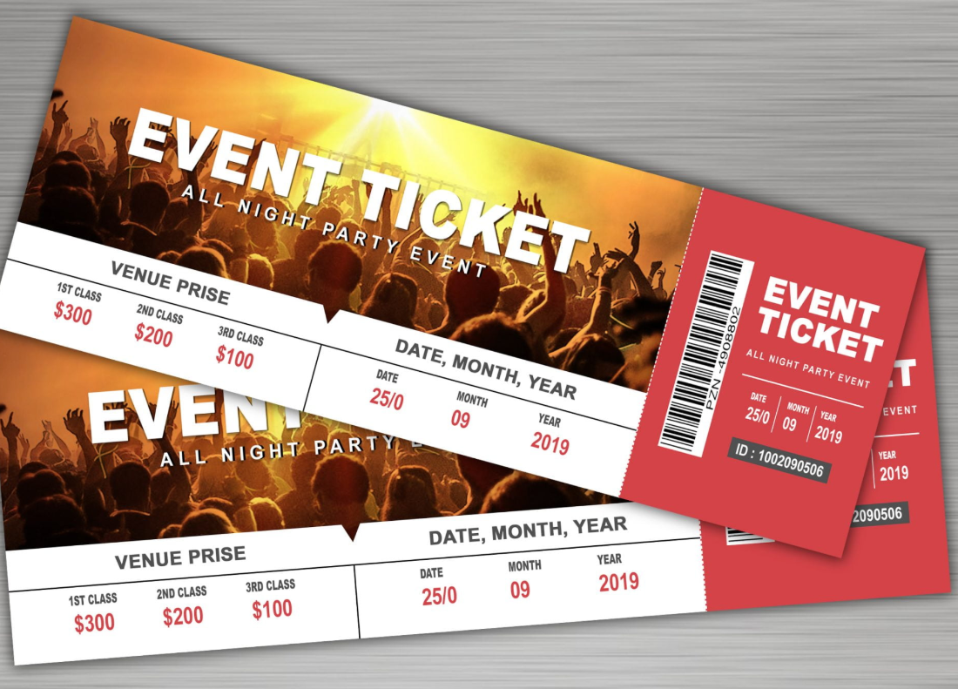
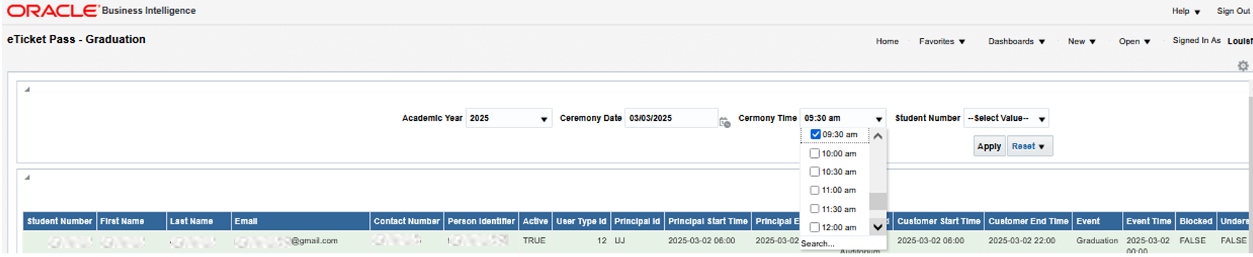
Graduation Guest Tickets
Past graduation access control process was manually with no validation
which caused
  overcrowding and
  a security risk
New processes includes
  An integration with Nimbus Solutions to
  generate e-tickets for all graduates and their guests and
  This prevent overcrowding and better security on the day

Slide 11
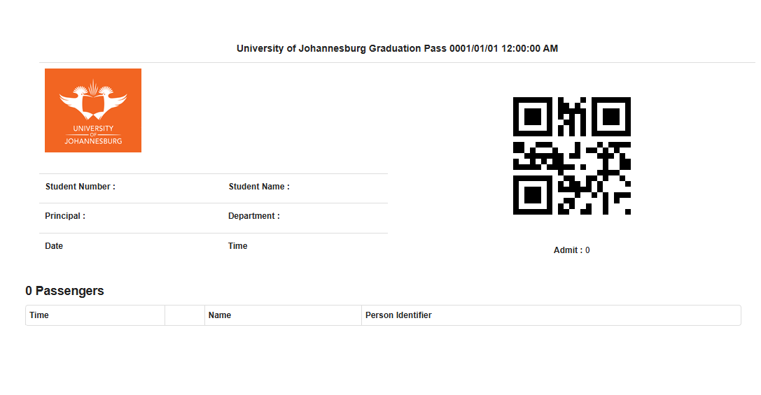
Graduation Guest Tickets
Graduate receives a link via Email and SMS to their eTicket to be used on the day of graduation.
A QR code on the ticket is then scanned by protection services to ensure that the guest is legal and can only be scanned 4 times ensuring duplication and illegal entrance.
After scanned a colored armband is supplied for entrance for further security

Slide 12


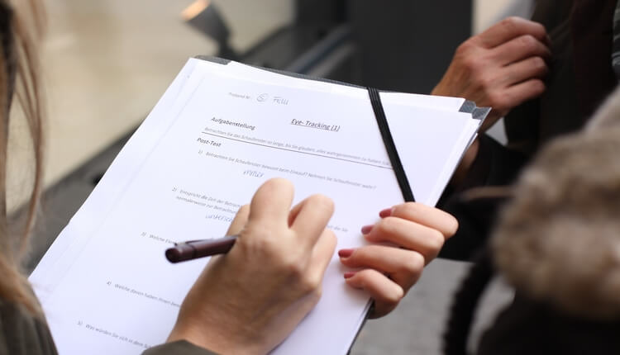

Graduation Satisfaction Survey
Notes:
Past printed survey was taken to the venue and graduates had to complete it after collecting the certificate backstage.
Additional staff paid to collect surveys
Paperwork to be captured and analysed after
New processes includes
Google survey form emailed to graduates after their ceremony
Analyses is readily available within Google Forms
No more paying of staff (4 temps per ceremony for 2 hours), printing paper and data caputuring
Analysis is immediately available

Slide 13
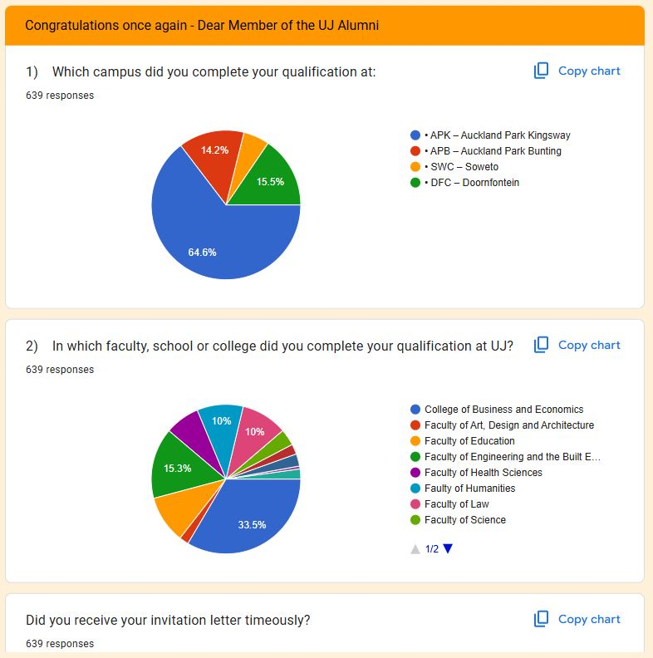
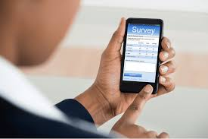
Graduation Satisfaction Survey
Notes:
Past printed survey was taken to the venue and graduates had to complete it after collecting the certificate backstage.
Additional staff paid to collect surveys
Paperwork to be captured and analysed after
New processes includes
Google survey form emailed to graduates after their ceremony
Analyses is readily available within Google Forms
No more paying of staff (4 temps per ceremony for 2 hours), printing paper and data caputuring
Analysis is immediately available

Slide 14

Business Process Modeling
1 Year Before
Ceremony dates populated in the year programme
Previous # plus 10
Graduates Comply Fictitious Date Captured
End Dec for Season 1
End Mar Season 2
Mid Aug Season 3
Communicate with Graduates
Letter 6 weeks before
eTicket 1 week before
Programme on website
November Summative Assessment
All candidates captured by end December
Summer
September October
10 ceremonies
n=1200
Autumn
March April May
60 ceremonies
n=12000
Winter
June
12 ceremonies
n=3000
January till 31 March
Special and Supplementary
1 April till End July
Masters and Doctoral
Special and Supplementary
01
02
03
04
05
Fictitious Dates Established
Sunday at 00:00 prior to the commencement of the season.
Split into Ceremonies of 230 candidates
Bulk Update to Actual Dates
Notes:
So we took our
Click - helicopter view of processes and
Click - the detail of the amount of work and
Click - reworked it into a business process flow chart by using Business Process Modeling tools

Slide 15



Graduation Business Process Flow
PHASE 2: Ceremony Preparation (SYSTEMS)
Update Graduates and create documents
PHASE 1 : Determine Graduates
PHASE 3: Final Preparation and Execute Ceremony
Notes:
By using business process modeling, we created a data-driven visual representation of our graduation business process. This is only the first step to a more automated and digitized process. After drawing up our business process we where able to analyse it and identify which part of the process takes the longest and are user intensive and try to automate it to save time and make it more reliable and without human error.
Click – We identified 3 phases to break down the process into smaller more manageable processes Phase 1 is how to determine graduates
Click – Phase 2 identified processes needed for preparation for the actual ceremony
Click – Phase 3 was the final preparation on the day of the ceremony and the execution of the ceremony

Slide 16
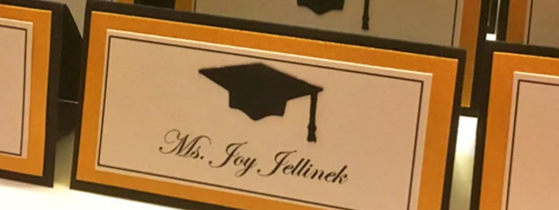
Graduating Seating Cards

Slide 17
Seating Card Business Process Flow
Stopped
Standardized
Modernized
Notes:
Click – Standardized the seating Allocation – saved money on Local Software
Click – Stopped validation of data for printing of the program as we automated the printing of the program as well
Click – Changed the tickets we used mail merging and had to manually printout cards if we wanted to add information, new modernized processed allows us to do this with easy configuration
Click – Modernized the Seating cards as it was hardcoded mapping was rigid and needed a developer to make changes to
Click – So what was the gain?
Click = We cut on Time consuming processes validating everything we did manually and this saved as Money

Slide 18
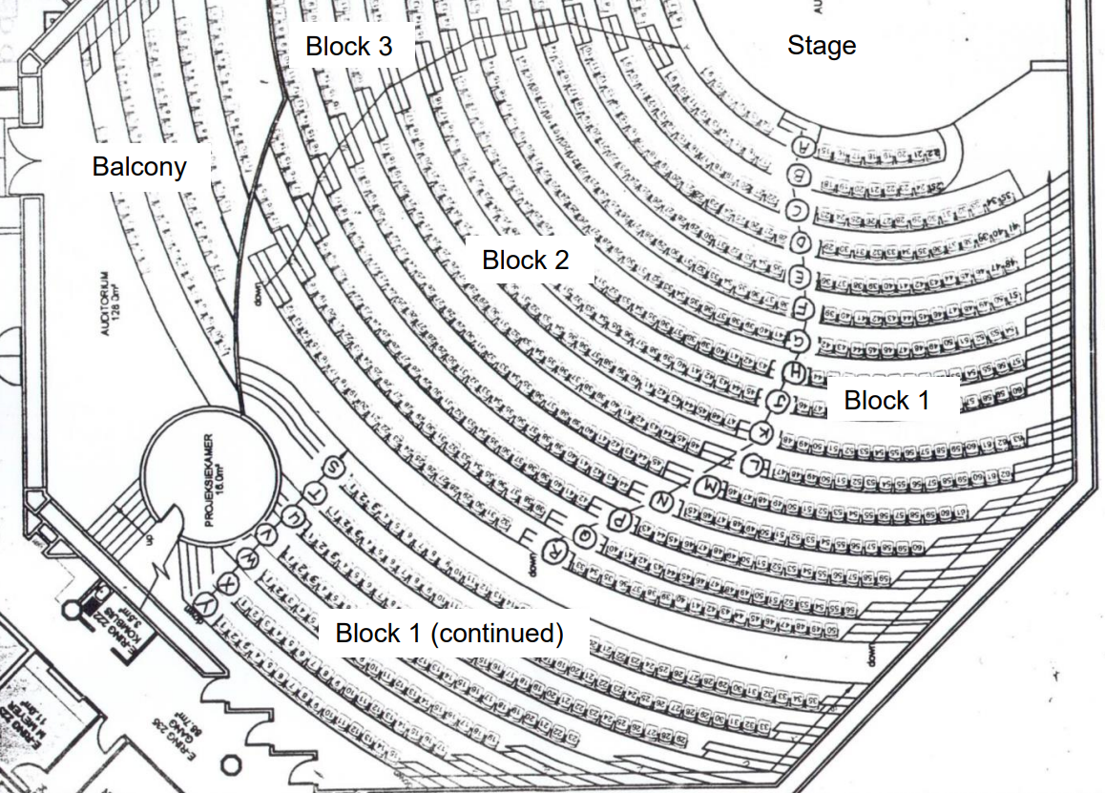
The venue
Notes:
The first hurdle to overcome is to determine where your graduates will be sitting and how to get them to sit in the right seat.
There is 3 processes to do this on ITSintegrator which will then allocate the seat numbers for the graduates automatically.

Slide 19
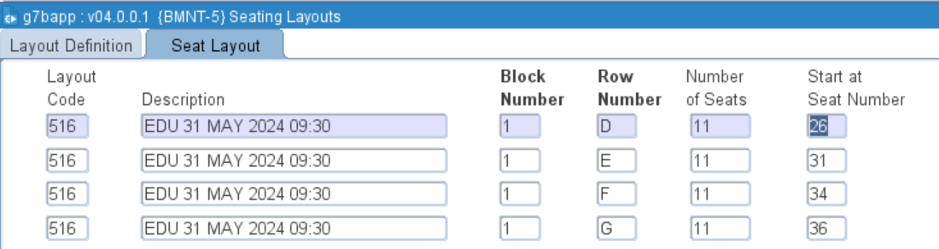
Venue data Preparation
(CAA+ Faculties)
Setup layout code
Create Booking number and link layout
Notes:
The first process is to allocating numbers to the seat. Seating Layout allows you to record the layout of the venue wrt blocks you want the graduates to sit in. How many rows are available, how many seats are available in that row and on which number to start.

Slide 20
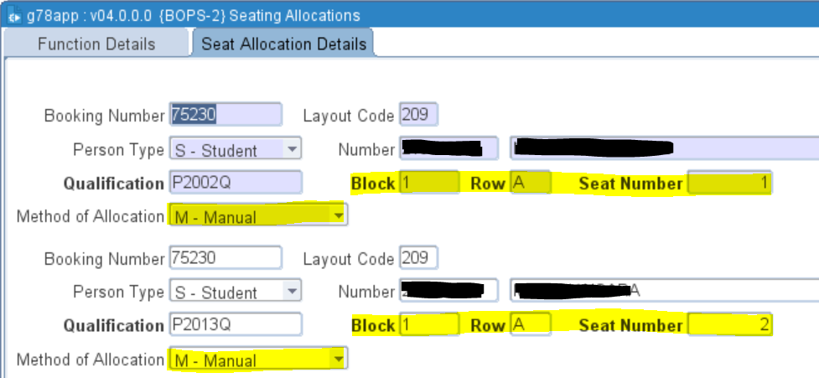
MANUAL Seat Allocation
Doctoral Graduates
Graduates with Disabilities
Notes:
The second process is to assign manual seats to your special graduates which in our case are the doctoral graduates and graduates with disabilites

Slide 21
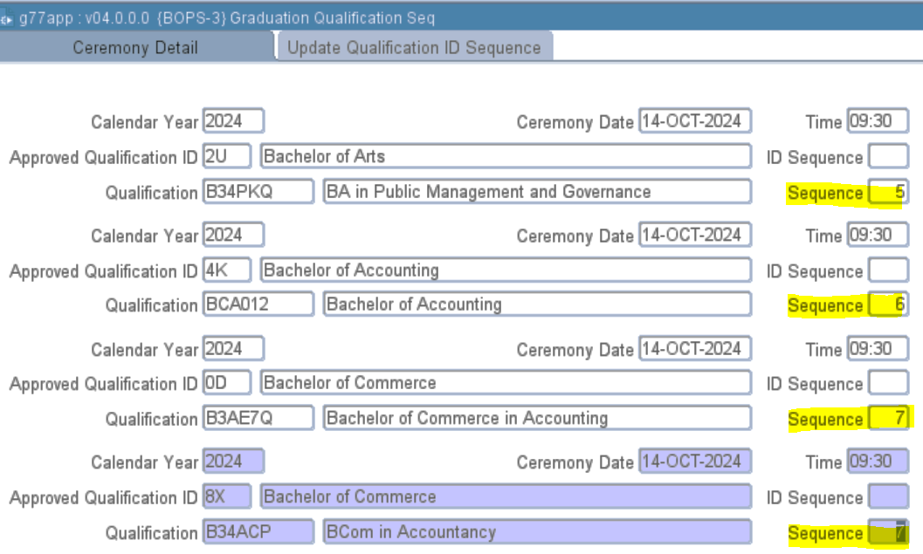
Sequence of Graduate Procession
More than one sequence can be allocated per Qualification OR
One sequence can be allocated to multiple qualification or approved qualifications
Notes:
The third process is to allocate a sequence to your qualifications which will be followed during the graduate procession.
Click – The sequences can be allocated per qualification or
Click – or the sequence can combine qualifications or approved qualifications together

Slide 22
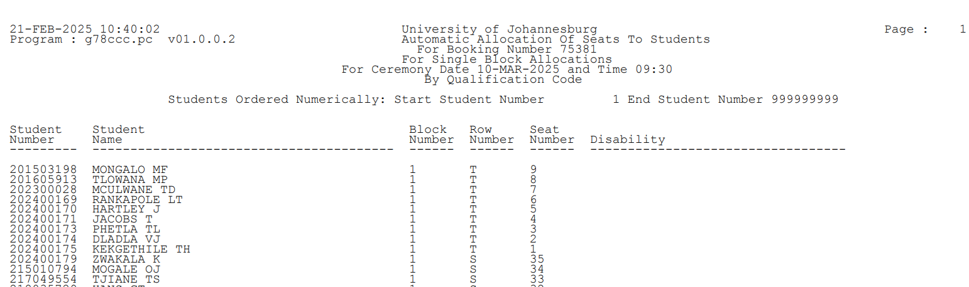

Allocation of Seats
The seating layout is used to determine the numbering
Notes:
Then you allocate your seats and whalah every graduate has a seat to sit, special graduates sits on reserved seats and other graduates are assigned a seat in the correct sequence for the actual ceremony to flow

Slide 23
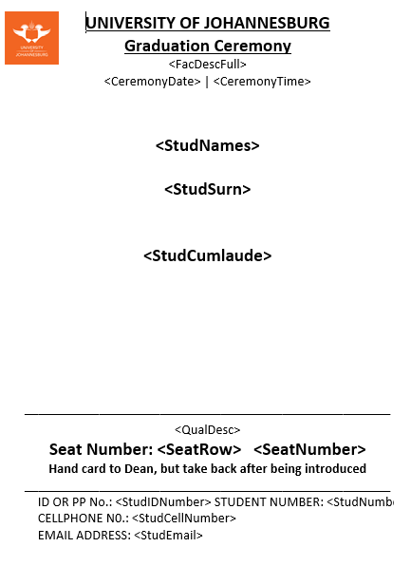













Generation of Seating Cards
Example of the RTF for the Undergraduate to Masters seating card layout.
Graduate information
Seating information
Identification information
Notes:
To make it even easier for staff and students we can now allocate what we call a seating card for each graduate which will stream line the ceremony process further. This card is given to the graduate to give to the ********* in order for them to read out the graduates accomplishments on stage.
Click – We used ITSintegrator icoms technology to design our seating cards which meant that we can change and print the cards without intervention of a developer which saves as time and money. Tags are used and to print personalized information on the A5 cardstock we use.
Click – the seating card identifies the graduate and what he graduates for and whether it was accomplished with distinction.
Click – The seating information is gathered from the allocation done automatically on the ITSintegrator system and indicates to the student where he needs to sit in the venue.
Click – the personal information is used to make sure we are giving the certificate to the correct person.

Slide 24
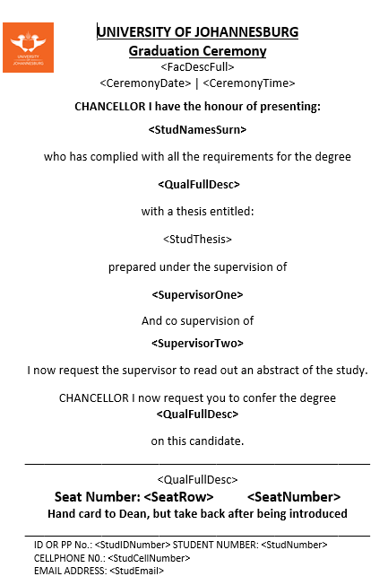















Example of the RTF for the Doctorates seating card layout.
Graduate information
Dissertation / Thesis Information
Seating information
Identification information
Notes:
A second layout could then be setup automatically which enables us to configure a different seating cards for doctorate candidates.
Click – Graduation information
Click – New dissertation information captured on ITSintegrator for the graduate
Click – Seating information
Click – Personal and security information

Slide 25
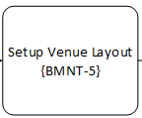
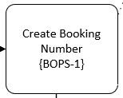
RECAP of Seating Card Process
Preparation
Manual and Automatic Allocation
Do manual Seat Allocation BOPS-2
Set Qual Sequence
BOPS-3
Do Seat Allocation BOPSR1-1
Print Seat Cards
Notes:
This is just a re-cap of the simplistic process UJ follows to manage a very complex process which if done incorrectly could lead to a mess during the actual ceremony process. You will find this in the little scrolls available after the session.

Slide 26
Benefit of Automation of Seating Cards
A single source of data are used, and no additional information are captured after the fact ensuring data integrity
Venue setup can be re-used in following ceremonies and thus only setup once
Seating cards can be printed or e-mailed
Seating cards are used for personal verification and security access and seating on reserved seats
Graduation procession are automated and structured
Reading of information are in sequence and for the correct candidate

Slide 27

Printing of Graduation Seating Cards

Slide 28
Overview of Past and Present Printing Processes
PAST:
Step1: Create and define Printer code
GPRT-1
Step 2: Link users to printer code
USERS-5 (B)
Step 3: Use 3rd party system COSPrint
Use Terminal to link and MAP Printer
PRESENT:
Step1: Create and define Printer code
GPRT-1
Step 2: Link users to printer code
USERS-5 (B)
Step3:Download, Extract and Email seating Cards
Notes:
Overview of Past and Present Printing Processes> this slide summaries or compares both PAST and PRESENT processes.
The first and second blocks (STEP 1& 2), coloured in orange, represent identical processes for both the Past and Present process.
The difference lies in how the present process is embedded within ITS. Previously, we used a third-party system as seen on Step 3.

Slide 29
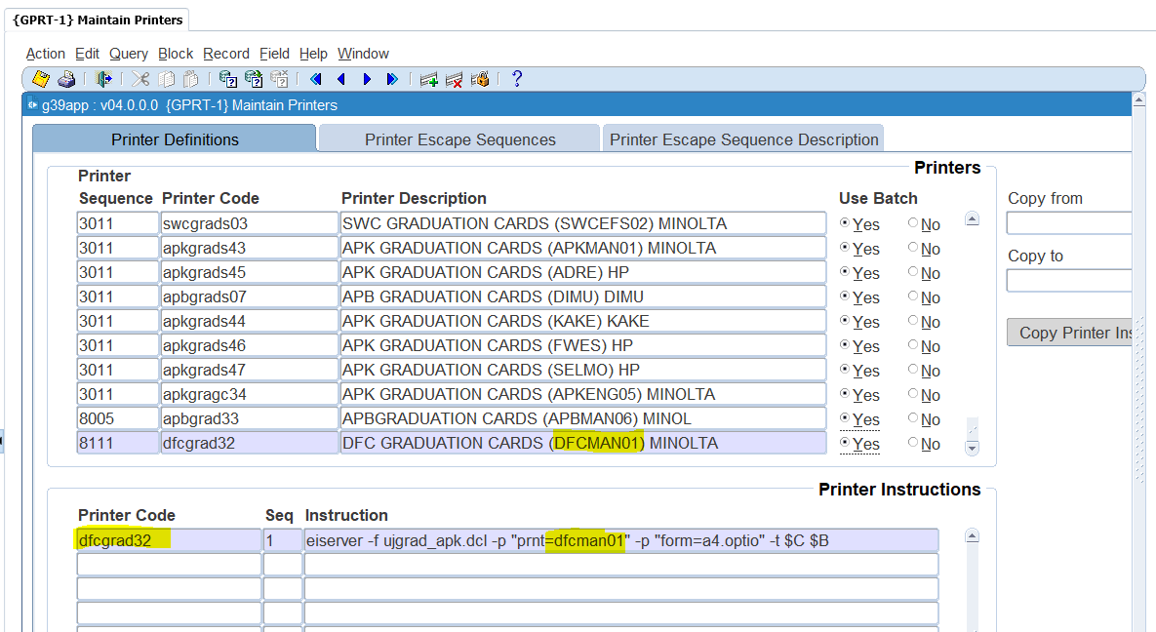
Step1: Printing Process: Past and Present
(GPRT-1):Link printer Sequence, Code, Definitions.
Link printer to Instruction e.g.
“/bin/lpr –dfcman01 $B”
Notes:
As previously stated, the Step 1 process is done both previously and presently. We use option (GPRT-1 Maintain printers): Link Printer Sequence, Code, and Definitions.
Then, we link the printer Instruction, which will be sent to your infrastructure specialist to associate the instruction with the printer IP.

Slide 30
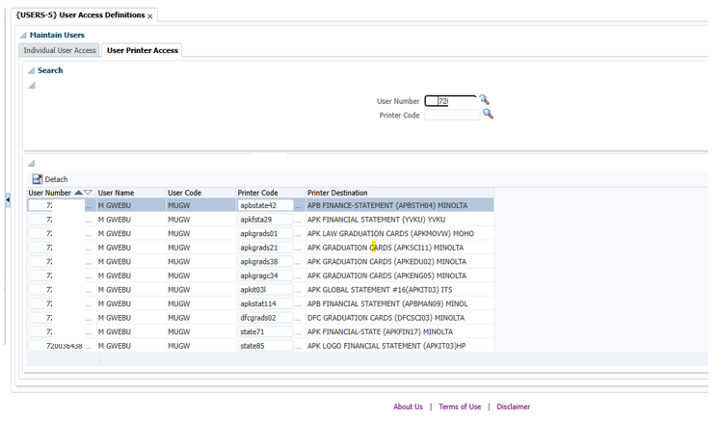
Step 2: Link User to printer code (Past and Present)
Notes:
On USERS-5 User access definition: We Link the user to the created Printer Code

Slide 31
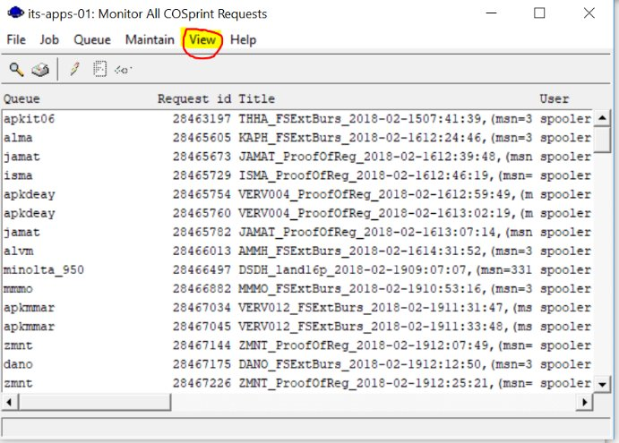
Step 3: Past Process: GUI COSprint Software
Previously we used 3rd part application (GUI) General User Interface application.
Link and Map: users to printer and the layout
Notes:
Step 3: This is where it differs: Previously, we used a third-party application (GUI – General User Interface) to link and map users to the printer and its layout.
One had to be knowledgeable on how to use this application and linking the users.

Slide 32
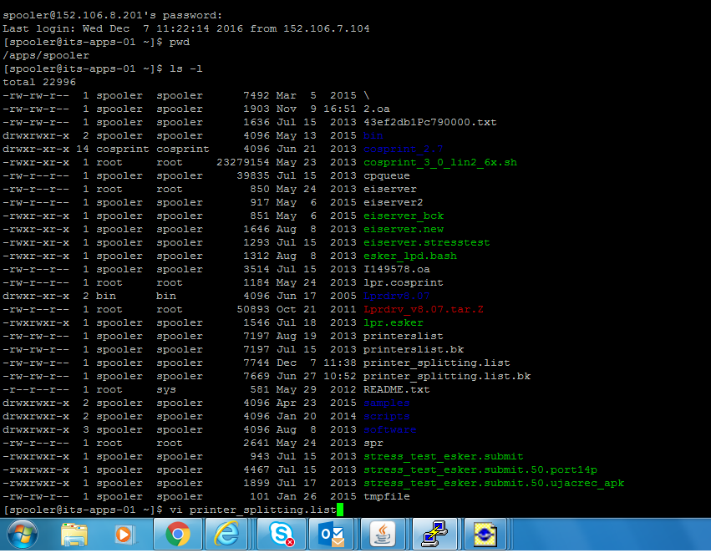
Past process: Used Terminal
Previously, we also used Terminal to execute commands to link and Map the printer layout
Inserting new printer onto the printing list:
1.ls –l => listing files within /apps/spooler directory
2.vi printer_splitting.list => open vi editor so that you can add new printer name
Notes:
We additionally, In the PAST we used Terminal to execute commands to insert new printer, link, list and Map the printer layout
To Inserting new printer onto the printing list: execute CMD
1.ls –l => listing files within /apps/spooler directory
2.vi printer_splitting.list => open vi editor so that you can add new printer name

Slide 33
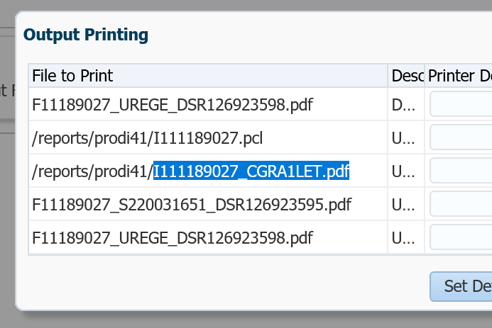
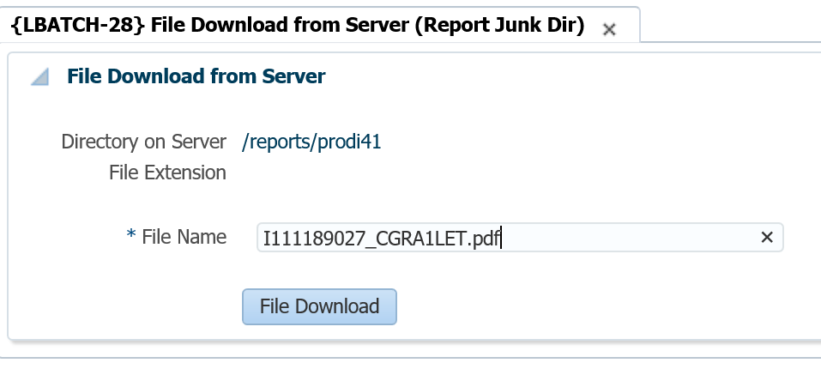
Step 3: Currently: Downloading of Grad seating card
Copy the file name you want to download as a PDF doc,
Can extract and email file.
Notes:
Currently: we can easily Copy the file name you want to download as a PDF doc, and we can extract and email the file.

Slide 34
Benefit of Printing Automation
Ease of Setup and Maintenance
Enhancing Productivity and ease of printing
Reduced costs of using 3rd party system
No need for additional training from 3rd party company

Slide 35

HISTORICAL PERSPECTIVE on
GRADUATION PROGRAMME CREATION

Slide 36

Manual Systems and Paperwork: A Historical Perspective
Do this 70X times over (one for each session)
FORMAT
1.Group qualifications in spreadsheet
Raw Format picture
Excel Picture
1.Transer data to Word
Word picture
Insert masters dissertations
Bold Headings
2. Order qualifications in spreadsheet
2. Apply formatting to document
INSERT
INSERT
Bold Surname and name
3.Group Students alphabetically for each group of qualifications in spreadsheet
Apply Line Spacing
INSERT
Apply Centering
INSERT
Add distinction
FORMAT
FORMAT
Apply Fonts
Insert Doctorates
Notes:
Historically the process was very long outstretched and exhausting
Click - Data was drawn using ITS and rendered in raw format.
Click - This was then cleaned up by removing spaces, grouping qualifications, ordering qualifications, ordering graduates in the group of qualifications. I lot of manual work and this was only for the editing of the name list.
Click – The data was then transferred to word and a lot of further formatting and inserting of additional information – Click click click
Click – no think on doing this 70 times a year, once for each graduation session
Click – EXHAUSTING Right?
BUT Wait there is MORE

Slide 37
Manual Systems and Paperwork: A Historical Perspective
Check printing
Convert Word
to PDF
Combine cover and inner contents
Send to printers
Wait for delivery
Store stacks of paper
Distribute programme to correct ceremony
Place on each chair
Discard programmes left behind
Notes:
Click - Then we have to convert our hardwork to a PDF version
Click – Combine this with other PDF information to make a full programme from cover to cover
Click – Send this to the printers
Click – Wait for delivery and then
Click – Check the printing, store the stacks of paper, distribute the program to the correct ceremony, place programme on each chair in time for the ceremony to start and then discard of all your hard work as people do not really care about a printed programme

Slide 38

Manual Systems and Paperwork: A Historical Perspective
Never ending spiral of lost time and cost
Notes:
It is just a never ending spiral of lost time and lost cost and depressing experience

Slide 39
Automation of Graduation Program Creation

Slide 40
Graduation Business Process Flow
Notes:
Here we are back again at our business process modeling flow, and we identified a 2nd process which needed a lot of time to make sure that it is correct, but which could be used together with our seating card process to be automated insuring correctness off data and less effort saving as time and money.

Slide 41
Graduation Business Process Flow
Enter CV & merit information
SACADT-1
Create Ceremony Program
Print Academic Transcript
Notes:
The creation of a graduation program could now be broken down into 2 additional setups
Click – namely the CV and Ledasiam information and
Click – Creation of the ceremony program and
Click – Printing of the Academic transcript in the same sequence as the graduation progression

Slide 42
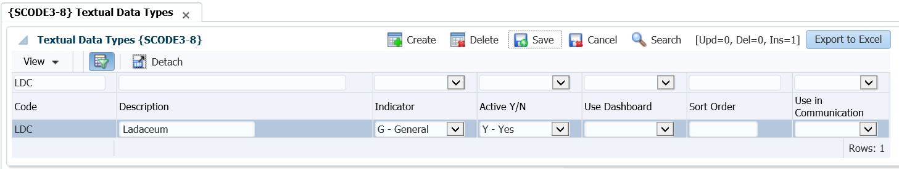
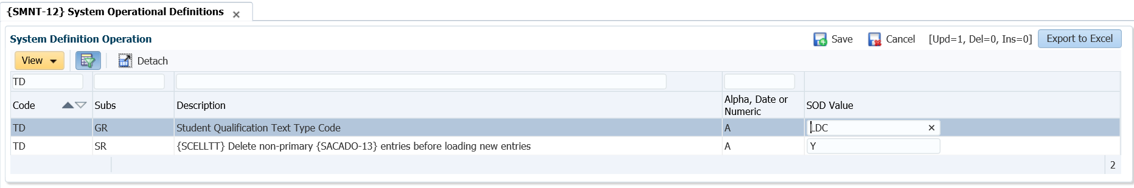
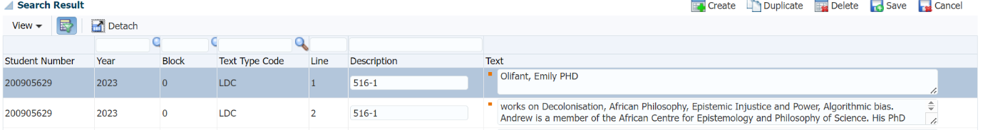
Setup CV / Laudation Information
Utilize Textual data types to identify CV information SCODE3-8
Link to new SOD to CV/Laudation Textual data – SMNT-12
Capture graduate CV Textual data – SACADT-1
Notes:
The setup of the CV can very easily be done by
Click – Defining the textual data type then
Click – Linking the type to an SOD to recognize it as a CV and
Click – Finaly entering the graduate’s CV information

Slide 43
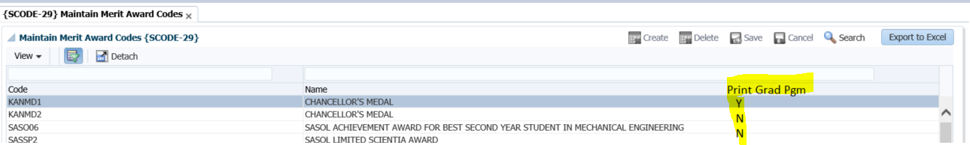
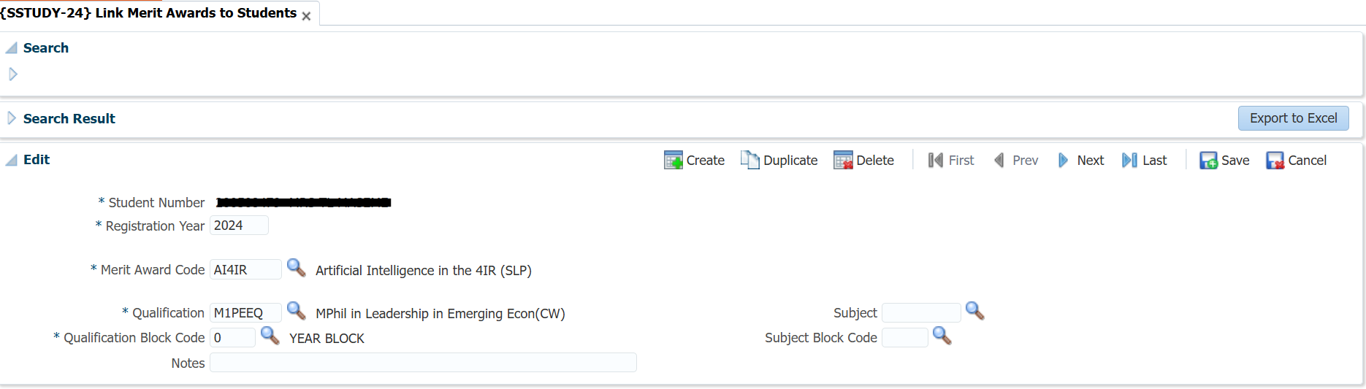
Setup Merit Reward Information
Identify which merit rewards you want printed on the Graduation Program
Link the graduate to the merit reward
Notes:
The setup of the Merit rewards can very easily be done by
Click – Identify which merit rewards you want printed on the Graduation Program
Click – Link the graduate to the merit reward

Slide 44
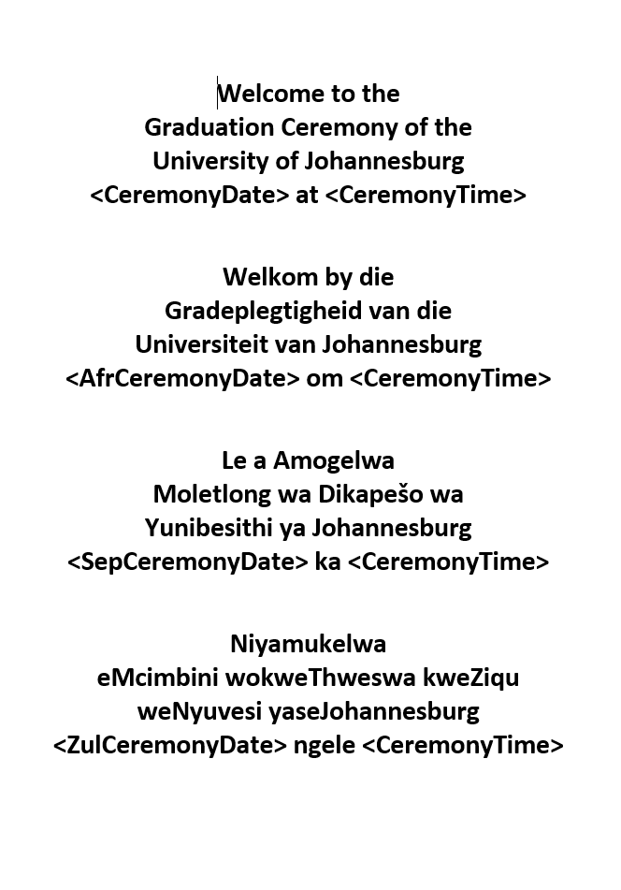
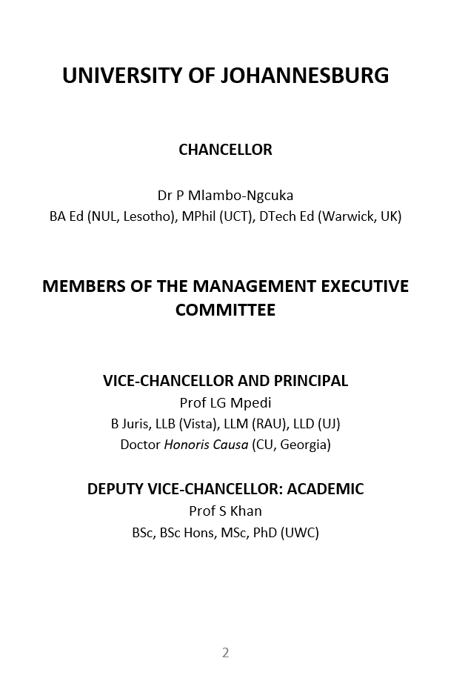




Generate PDF Graduation Program
Notes:
We again used the icoms technology on ITSintegrator to automate and generate a program from data already captured on the system. This means that we do not have to manually capture or use mail merge to create a ceremony outside of the ITS system.
Click - Our ceremony programs welcome statement is in four languages and we used specific tags to make this possible
Click - The static information of the program are typed on the rtf used and can easily be changed if some of the information changes from ceremony to ceremony or from year to year
The use of icoms also allows us to e-mail the program to all graduates which saves a lost of printing costs.

Slide 45

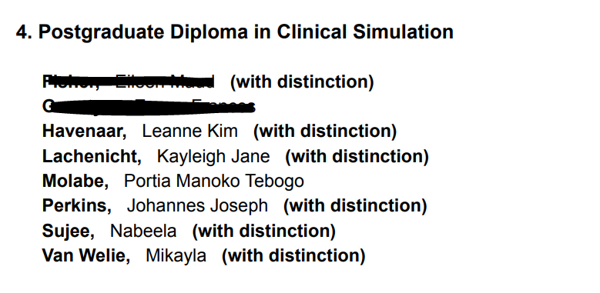
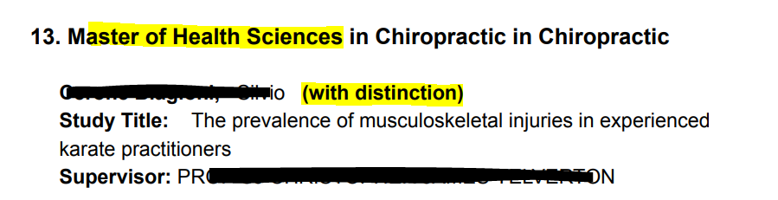
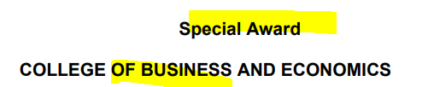
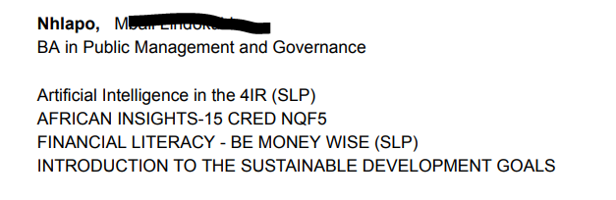
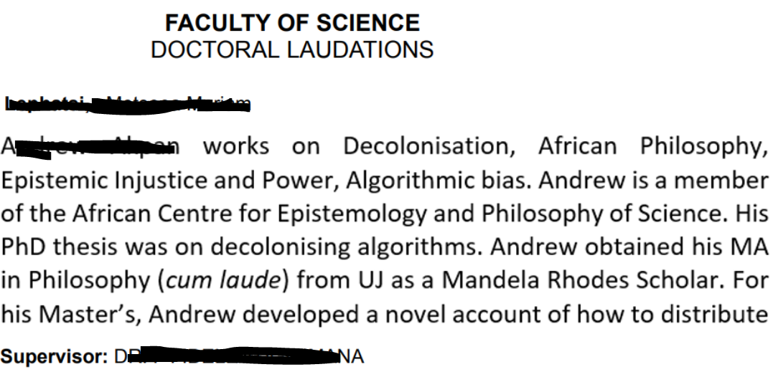










The data of the graduates are divided into 3 categories representing different data as setup previously
Approved ID description and Qualification Full name are printed
Tag <StudGradProgramme> refers to the qualification and graduate information in the same sequence as the seating cards
<StudMerit_R>
Tag <StudMerit_R> refers to the merit rewards captured previously
<StudTextualRemark_R>
Tag <StudTextualRemarks_R> refers to the graduate Laudations and CV
Notes:
The rtf for the icoms technology are setup into 3 categories of data already captured and no additional information need to be typed manually on the program
Click - Tag StudGradProgramme refers to the qualification and graduate information in the same sequence as the seating cards.
Click – Note the Approved ID description and Qualificaiton Full name are printed as the heading of the program and then the student’s who graduates under this heading
Click – Tag StudMerit refers to the merit rewards already captured and
Click – StudTextualRmarks refers to the graduate CV and Laudations also previously entered.
All data is thus available on the system and ready to be used. This again saves a lot of time and effort from staff and programms need not be manually typed up and validated to ensure correctness.

Slide 46
RECAP of Generation of Graduation Programme
Preparation
Capture
CV & Laudation
Capture
Merit Rewards
Setup tags on rtf
<StudGradProgramme
<StudMerit_R>
<StudTextualRemarks_R>
Graduation Programme
Notes:
This is just a re-cap of the simplistic process UJ follows to manage the graduation programme and making sure that ceremony chaos are prevented and data integrity are upheld

Slide 47
Benefit of Automated Programme Generation
A single source of data are used, ensuring data integrity
Ease of distribution to graduates
Cost saving due to electronic distribution and doing away with printing.
Graduation procession and program are in sync

Slide 48

Technological Tools & Systems

Slide 49
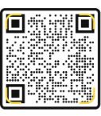



Technological Tools & Systems in Use Today

Slide 50



Technological Tools & Systems in Use Today
Notes:
BPMN – Business Process Modelling tools

Slide 51



Total Benefit
Cost
Accuracy
Time

Slide 52

UJ Graduation in the Future
Automated process on outstanding fees and payment influencing packing of scrolls
Verification of payments and release of certificates
Facial Recognition for further security and control
Replacing Barcodes on ITSi with QR codes will eliminate integrations needed
Notes:
Further Process mapping to identify automation / technology opportunities which could include
Outstanding fees and payments automation
Verification of payments on the ceremony date and release of certificates timeously
Facial recognition can ensure further security on the day of the ceremony

Slide 53

the BIG answer
Technology is making our graduation planning and execution EASIER, BETTER, FASTER
AND MORE SECURE!

